Slide 1
TEAM - 7

Slide 2
JUKE-JINIE is a media player is an application that allows users to play various types of media files, such as audio and video files. It provides basic controls for playback, such as play, pause, stop, rewind, and fast forward. Also have some advanced features like setting different visualizers while playing the audio.
To this application, we will use certain number of application concepts to build this such as gstreamer and graphical user interface.
In gstreamer we will use concepts of seeking and in gui we will use the concepts of creating certain buttons and many more things to build this application.

Slide 3
GSTREAMER
GStreamer is an open-source multimedia framework that allows developers to create multimedia applications and pipelines for playback, recording, streaming, and processing of audio and video data.
Here some of uses and applications of gstreamer:
Cross-platform: GStreamer is available on various operating systems, including Linux, macOS, Windows, iOS, and Android. This makes it a popular choice for developers who need to create multimedia applications that run on multiple platforms.
Modular architecture: GStreamer has a modular architecture that allows developers to build complex multimedia pipelines by combining various plugins. These plugins can be added or removed as needed, making it easy to customize the pipeline for specific use cases.

Slide 4
Large plugin library: GStreamer has a large library of plugins that can be used to handle different types of audio and video data, such as encoding, decoding, filtering, and playback. These plugins are open source and community-driven, which ensures a high level of quality and reliability.
Easy to use: GStreamer has a simple and intuitive API that makes it easy for developers to get started with multimedia programming. The API is well-documented and supported by a large community of developers who can provide help and advice.
High performance: GStreamer is designed to be efficient and optimized for performance. It uses hardware acceleration, such as GPU processing and SIMD instructions, to ensure that multimedia pipelines can handle high volumes of data without causing performance issues.
Customizable: GStreamer is highly customizable, allowing developers to create custom plugins and pipelines that meet their specific requirements. This flexibility makes it an ideal choice for building multimedia applications that require specific functionality or performance.

Slide 5
SEEKING
Seeking in GStreamer refers to the ability to jump to a specific point in a media stream, such as a specific time in a video or a specific sample in an audio stream.
The seek event is used to initiate a seek operation in a GStreamer pipeline. The event specifies the target position in the stream and the direction of the seek operation (i.e., forward or backward). The pipeline responds to the event by seeking to the specified position.
The seek query is used to query the pipeline about its seeking capabilities. The query returns information about the pipeline's ability to seek to specific positions in the stream, such as the available seekable ranges and the precision of the seek operation.
GStreamer also provides a seek flag mechanism that allows developers to specify how seeking should be handled in their pipelines. The seek flags provide additional control over the seeking operation, such as whether to perform accurate seeking (i.e., seeking to the exact position requested) or keyframe seeking (i.e., seeking to the nearest keyframe).

Slide 6
There are several types of seeking supported by GStreamer, including:
1] Accurate Seeking: Accurate seeking refers to seeking to an exact position in a media stream, such as a specific timestamp in a video or a specific sample in an audio stream. Accurate seeking is useful for precise editing or navigation in a media stream, but it can be slower than other seeking methods.
2]Keyframe Seeking: Keyframe seeking refers to seeking to the nearest keyframe in a video stream. Keyframes are frames that contain complete image information, while non-keyframes (also known as delta frames or P-frames) only contain changes from the previous frame. Seeking to a keyframe can be faster than accurate seeking because the decoder can start decoding from the nearest keyframe, rather than having to decode every frame between the current position and the target position.
3]Segment Seeking: Segment seeking refers to seeking to a specific segment of a media stream, such as a specific section of a video or audio file. Segment seeking is useful for playing or editing specific portions of a media stream.
4]Forward and Backward Seeking: Forward seeking refers to seeking forward in a media stream, while backward seeking refers to seeking backward. Both types of seeking can be useful in different scenarios, such as navigating a video stream forward or backward to find a specific scene.

Slide 7
GUI
GStreamer provides support for building graphical user interfaces (GUIs) through integration with various GUI toolkits, such as GTK and Qt. These toolkits provide a range of widgets and controls that can be used to build custom GUIs for media applications.
GStreamer supports a variety of GUI-related features, including:
1] Embedding video into GUI elements: GStreamer allows developers to embed video and other media into GUI elements, such as a video player or a media thumbnail.
2] Displaying media metadata: GStreamer can extract metadata from media files, such as title, author, and description, and display them in a GUI.
3]User interaction: GStreamer provides mechanisms for allowing user interaction with media, such as seeking to specific positions in a video, changing the volume, and displaying subtitles.
4]Customization: GStreamer allows developers to customize the appearance and behavior of their GUIs, such as changing the layout, adding custom controls, and providing theme support.

Slide 8
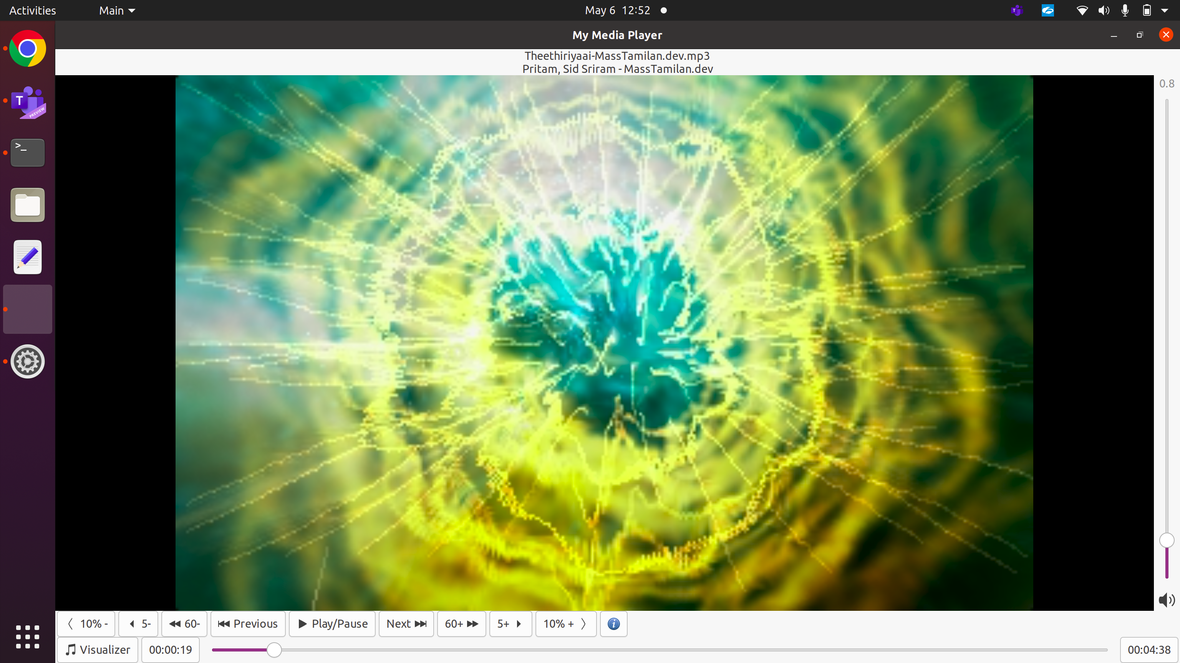

Slide 9
In the above slide,that is the project we did using gstreamer components and gui applications[graphical user interface].
Play/pause button : In a media player built with GStreamer, the play/pause button is a common UI control that allows the user to start or pause playback of a media stream. When the user clicks the play button, the media player sends a play command to the GStreamer pipeline, which causes the pipeline to start playing the media stream. When the user clicks the pause button, the media player sends a pause command to the pipeline, which causes the pipeline to pause playback of the media stream.The play/pause button is an important UI control in media players built with GStreamer, as it allows users to control the playback of media streams. Developers can customize the appearance and behavior of the play/pause button, such as adding animations or changing the button label, to provide a more engaging user experience.
Next button: In a media player built with GStreamer, the next button is a UI control that allows the user to skip to the next track or chapter in a playlist or media stream. When the user clicks the next button, the media player sends a seek command to the GStreamer pipeline, which causes the pipeline to seek to the next track or chapter in the media stream.The behavior of the next button may vary depending on the type of media being played. For example, in a music player, the next button may skip to the next song in a playlist, while in a video player, the next button may skip to the next chapter or scene in a video.
60++ : Button that allows the user to seek forward by a certain number of seconds, such as a "60++" button that seeks forward by 60 seconds. In GStreamer, this type of button can be implemented using a seek function. For using this
60-- : Button that allows the user to seek backward by a certain number of seconds, such as a "60--" button that seeks back by 60 seconds. In GStreamer, this type of button can be implemented using a seek function.

Slide 10
5+ : "+5 button" can refer to a UI control that allows the user to seek forward by a certain number of seconds, such as a button that seeks forward by 5 seconds when clicked.
5- : "+5 button" can refer to a UI control that allows the user to seek backward by a certain number of seconds, such as a button that seeks backward by 5 seconds when clicked.
< 10% : "<10% button" can refer to a UI control that allows the user to seek backward by a certain percentage of the media's duration, such as a button that seeks back by 10% of the media's duration when clicked.
10% > : "<10% button" can refer to a UI control that allows the user to seek forward by a certain percentage of the media's duration, such as a button that seeks forward by 10% of the media's duration when clicked.

Slide 11
THANK YOU
Visit us at www.sasken.com
Queries: marketing@sasken.com

